Slide 1

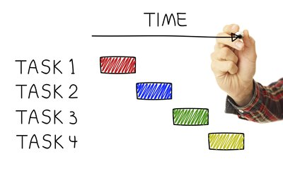
Project Selection
Chapter 4
“To invest or Not to invest, that is the question!”

Slide 2
Project Selection
Project: A complex, non-routine effort limited by time, budget, resources and performance specifications designed to meet customer need
Mutually exclusive projects means that if one project is taken on, the other must be rejected
Independent projects means that the selection of one project does not affect the other project
Project Selection Methods:
Net Present Value (NPV)
Internal Rate of Return (IRR)
Pay back period
Benefit Cost Ratio (B/C ratio)

Slide 3
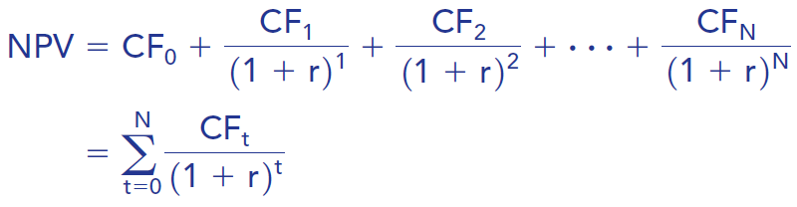
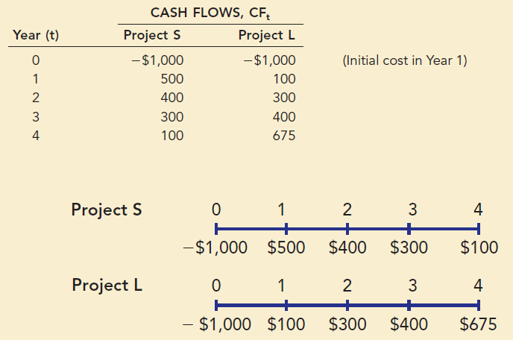
1. Net present value or present worth
Determines whether the project is or is not an acceptable investment.
Example 1.1:
Initial cost at yr 0
Decision Rule: Project with a higher NPV is to be selected (for mutually exclusive projects)
Consider 10% cost of capital

Slide 4
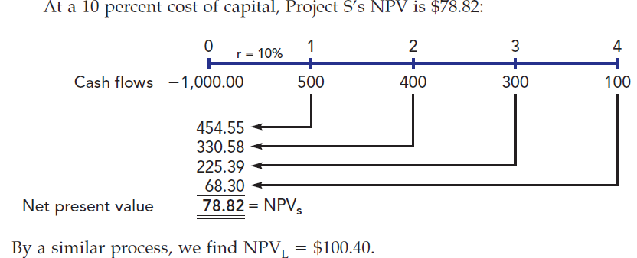
Solution 1.1:

Slide 5
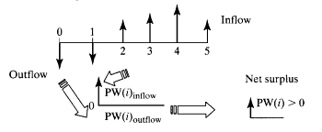
Single Project:
Principle: Compute Net Present Value for a given interest rate of i
Decision Rule: Accept the project if the NPV is positive
Comparing More Than One Alternative
If you need to select the best alternative, based on the net-present-worth criterion, select the one with the highest PW or NPV, as long as all the alternatives have the same service lives.

Slide 6
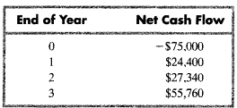
Problem for practice 1.2:
Tiger Machine Tool Company is considering the acquisition of a new metal cutting machine. The required initial investment of $75,000 and the projected cash benefits over a three-year project life are as follows. You have been asked by the president of the company to evaluate the economic merit of the acquisition. The firm's MARR (Minimum Annual Rate of Return) is known to be 15%. Find NPV for the project and calculate whether the project should be selected or not

Slide 7
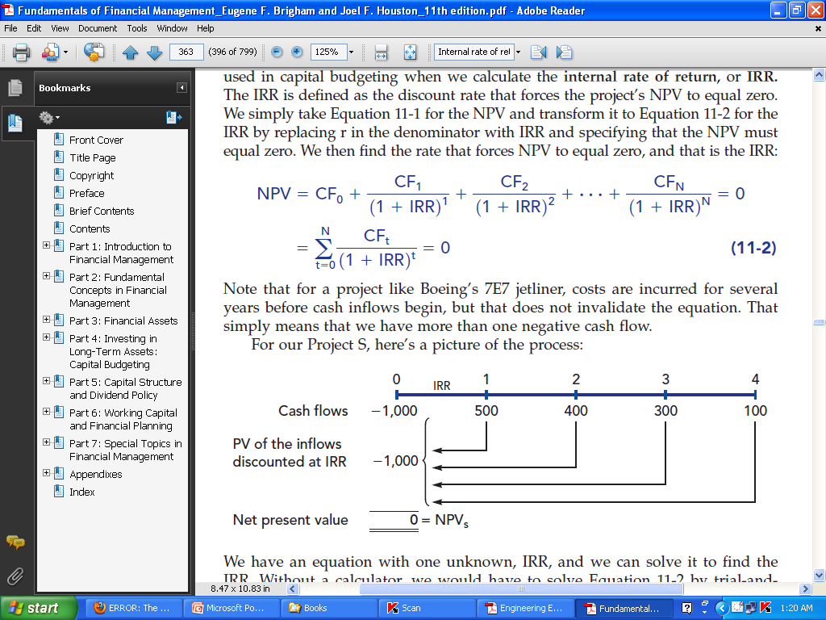
2. Internal Rate of Return (IRR)
The IRR is defined as the discount rate that forces the project’s NPV to equal zero.

Slide 8
Computational methods for IRR
The most practical methods are-
Direct-solution method,
Trial-and-error method.
Strategies:
Check if the projects fulfilled the selection criterion .(IRR>given rate)
If mutually exclusive, the project with higher IRR will be selected
If independent, both the project can be selected

Slide 9
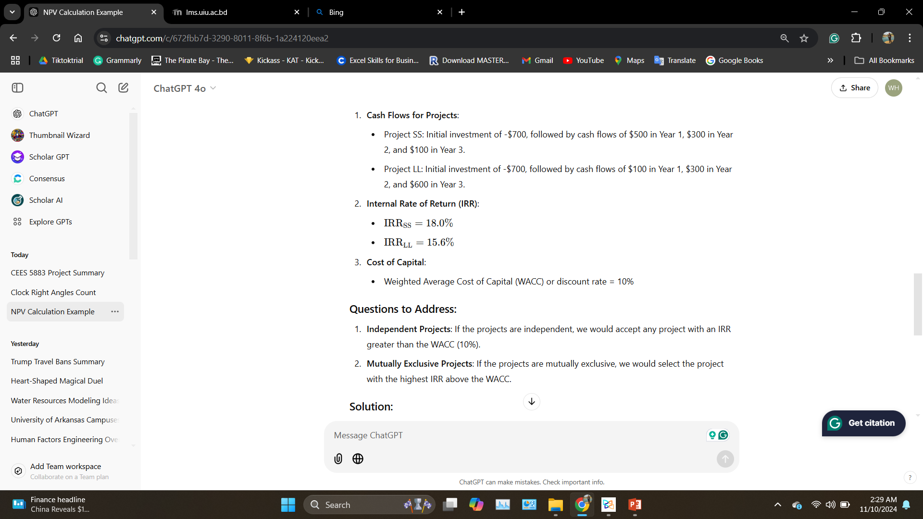
Example 2.1:
Solution:
(a) Independent: Accept both projects SS and LL.
(b) Mutually Exclusive: Select Project SS.

Slide 10
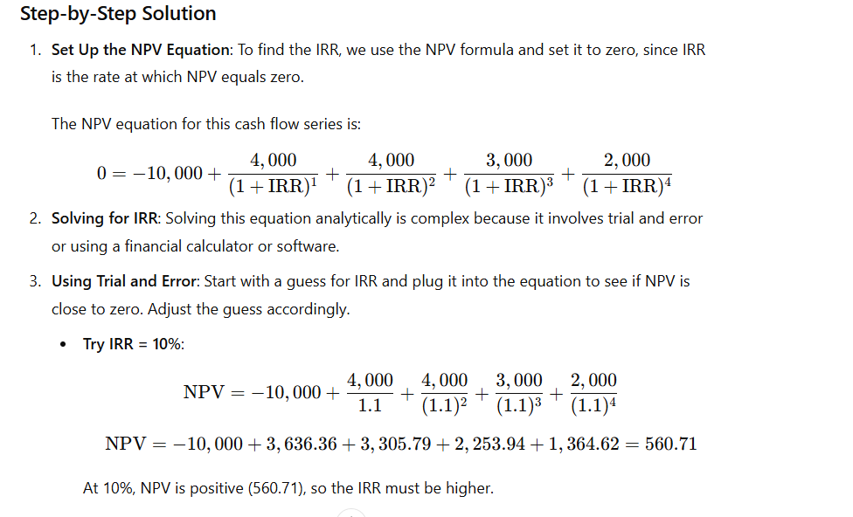
Example 2.2;
A company is considering a project with the following cash flows:
We want to calculate the IRR
Answer:
Year | 0 | 1 | 2 | 3 | 4
 | -10000 | 4,000 | 4,000 | 3,000 | 2,000

Slide 11
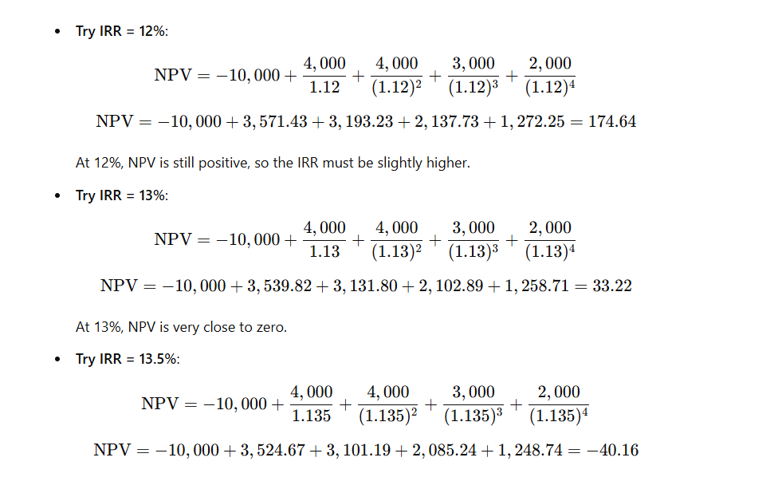

Slide 12
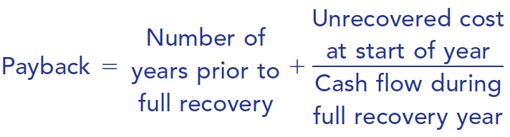
Payback period
payback period, defined as the number of years required to recover a project’s cost from operating cash flows.
Two types-
conventional-payback period-doesn’t consider the cost of fund
discounted-payback period- considers the cost of fund

Slide 13
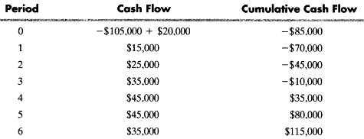
Example -1: conventional payback period
Ashland Company has just bought a new spindle machine at a cost of $105.000 to replace one that had a salvage value of $20,000. The projected annual after tax savings due to improved efficiency, are as follows:
Here a negative balance of $10,000 remains at the start of year 4. If the $45,000 is expected to be received as a more or less continuous flow during year 4, then the total investment will be recovered two-tenths ($10,000/$45.000) of the way through the fourth year. In this situation, the prorated payback period is thus 3.2 years.
Note: Find, discounted-payback period, Consider i=15%. Depending on the cash flow assumption, the project must remain in use for about 4.2 years

Slide 14
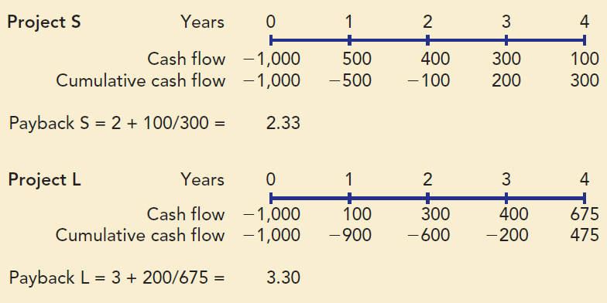
Example 2 (Conventional Payback Period calculation)
years
years

Slide 15
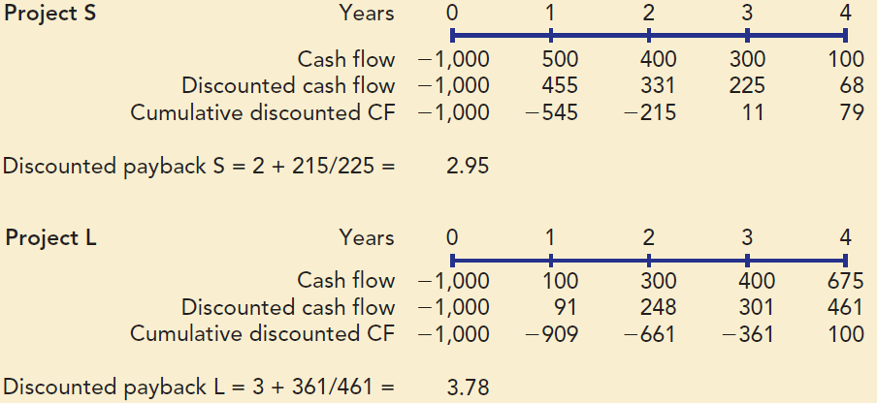
Discounted Payback Calculations at 10% Cost of Capital

Slide 16
Benefit Cost Analysis
Define users as the public and sponsors as the government.
The general framework can be summarized as-
Identify all users' benefits (favorable outcomes) and disbenefits (unfavorable outcomes) expected to arise from the project.
Quantify, as much as possible, these benefits and disbenefits in dollar terms so that different benefits and the respective costs of attaining them may be compared.
Identify the sponsor's costs and quantify them.
Determine the equivalent net benefits and net costs at the base period (usually year 0); use a discount rate appropriate for the project.
Accept the project if the equivalent users' net benefits exceed the equivalent sponsor's net costs.
Overall users’ benefit= benefits-disbenefits
Sponsor's costs = capital costs + operating and maintenance costs - revenues

Slide 17
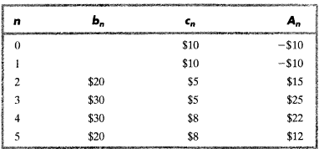
Benefit-Cost Ratio
Way of expressing the worthiness of a public project is to compare the user's benefits (B) with the sponsor's costs (C) by taking the ratio B/C- called Benefit-Cost ratio.
Example 1: A public project being considered by a local government has the following estimated benefit-cost profile-
Assume that i = l0%, N = 5, Compute Benefit cost ratio B/C. And decide whether the project should be selected or not

Slide 18
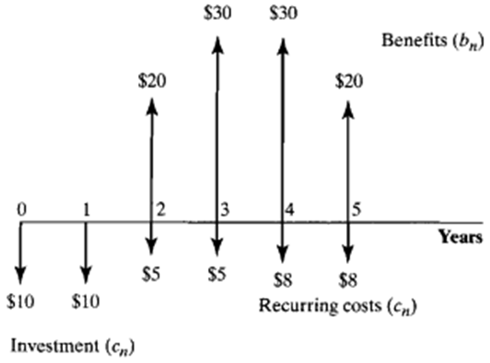
Example-1
Solution:
We calculate B as follows:
B = $20(P/F, l0%, 2) + $30(P/F, l0%, 3)+ $30(P/F, l0%, 4) + $20(P/F, 10%, 5)
= $71.98.
We calculate C as follows:
C = $10+ $10(P/F, l0%, 1) + $5(P/F, l0%, 2) + $5(P/F, l0%, 3) +
$8(P/F, 10%, 4)+ 8(P/F, 10%, 5)
= $37.41

Slide 19

………Continued
We calculate B/C ratio as follows
The B/C ratio exceeds one. so the user's benefits exceed the sponsor's costs.

Slide 20


